Slide 1

HOTEL REVIEW CLASSIFICATION
P346 Group-1
Mentor: Bhanupriya
29/JAN/24

Slide 2
Business Problem:
Classifying Hotel Reviews to Positive and Negative using Text Mining
Objective:
This is a sample dataset which consists of 20,000 reviews and ratings for different hotels and our goal is to examine how travelers are communicating their positive and negative experiences in online platforms for staying in a specific hotel and major objective is what are the attributes that travelers are considering while selecting a hotel. With this manager can understand which elements of their hotel influence more in forming a positive review or improves hotel brand image.

Slide 3
Project Architecture / Project Flow
Data Preprocessing
Feature Engineering
Train-Test Split
Model Selection
Model Training
Model Evaluation
Prediction
Deployment

Slide 4
Exploratory Data Analysis (EDA) and
Feature Engineering

Slide 5
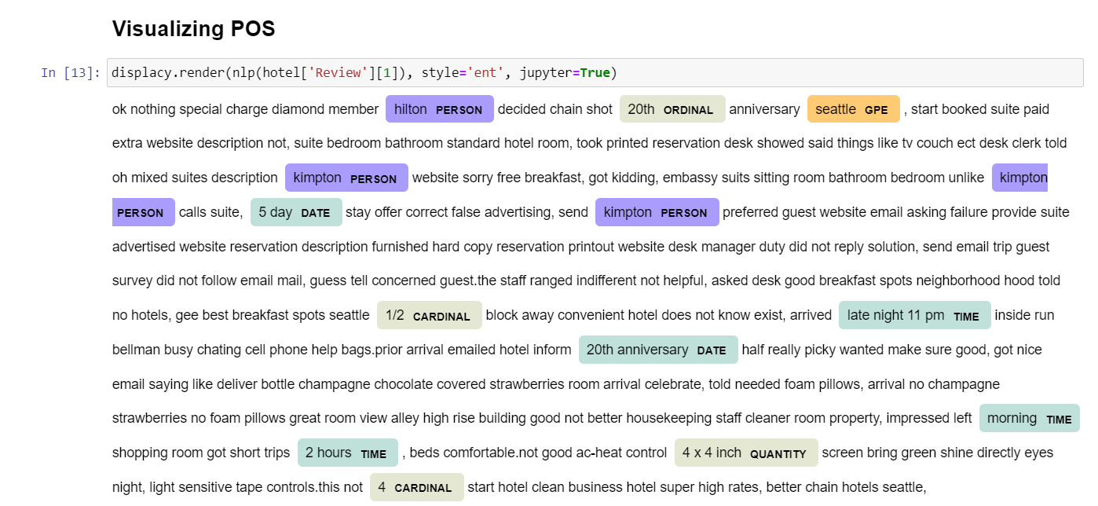
Exploratory Data Analysis (EDA)
In the Entity visualization, we can see different entities highlighted such as person, place, time, ordinal we can also observe the NERs used in the reviews if any.

Slide 6
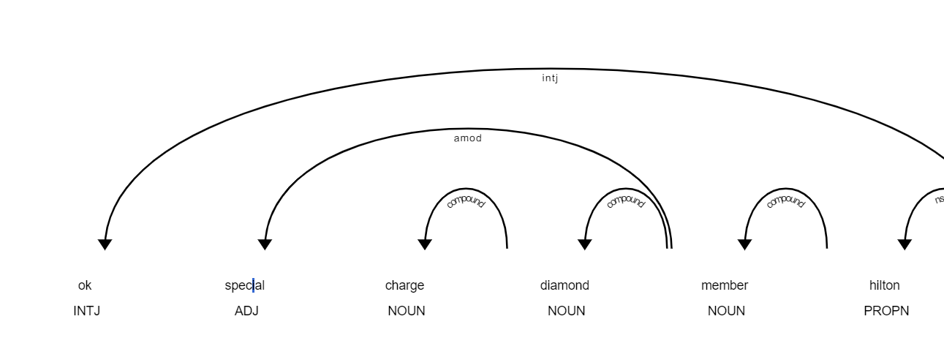
Exploratory Data Analysis (EDA)
In the Dependency visualization, we can see different relations among the different words in the sentence of a review

Slide 7
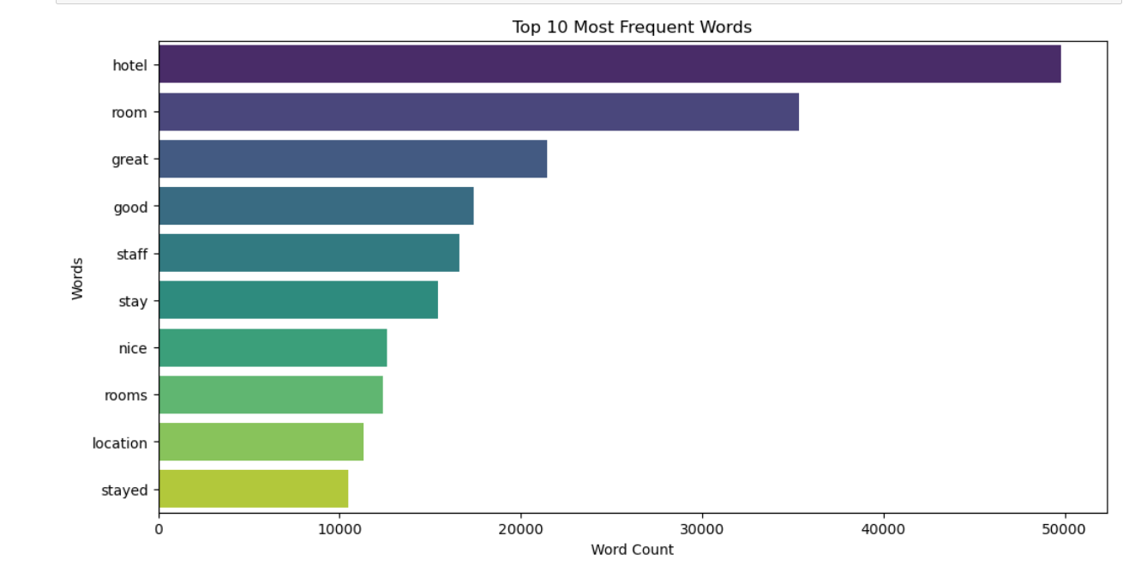
Exploratory Data Analysis (EDA)
In the above barplot, we can observe the top 10 frequenet words in the reviews, the word ‘hotel’ has the highest occurence followed by room and others
By this plot we can pick out the necessary words that are helpful for the text processing/Sentimental analysis.

Slide 8
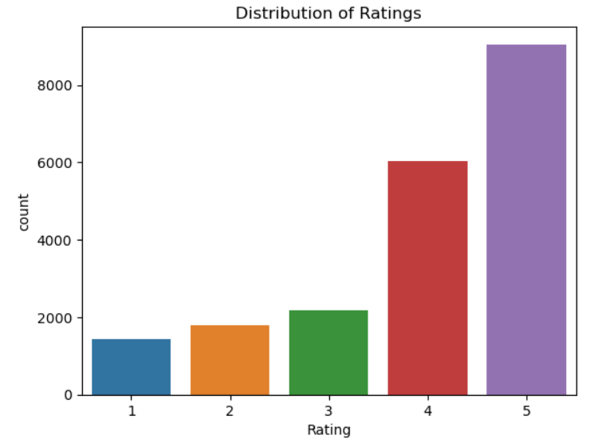
Exploratory Data Analysis (EDA)
In the ratings barplot, we can see the distribution of the ratings of the reviews in the dataset
As we can see that most of the reviews in this dataset are positive compared to the neutral and negative reviews

Slide 9
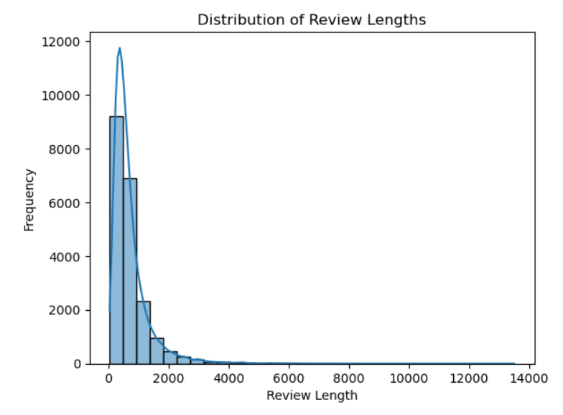
Exploratory Data Analysis (EDA)
In this distribution, we can see the frequency of review length of the reviews.
Most of the reviews are having words on average of 1500

Slide 10
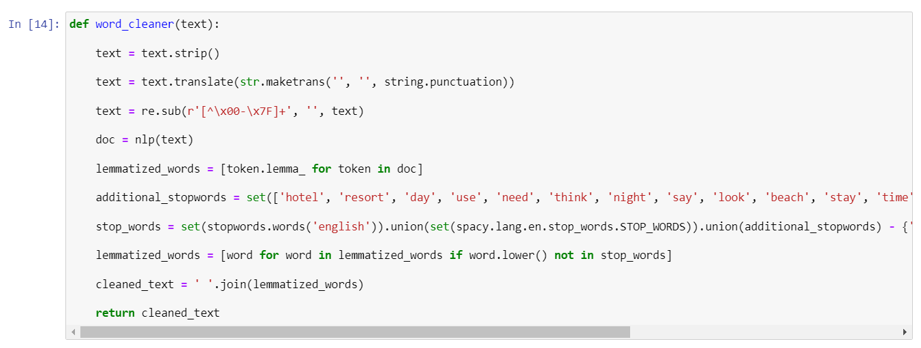
Feature Engineering
Since we need to clean the words and remove unnecessary characters, we are applying word cleaner to the reviews to a new column

Slide 11
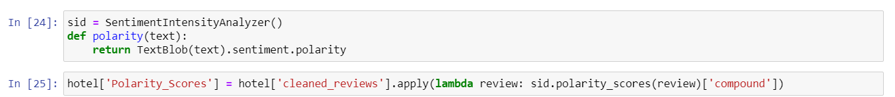
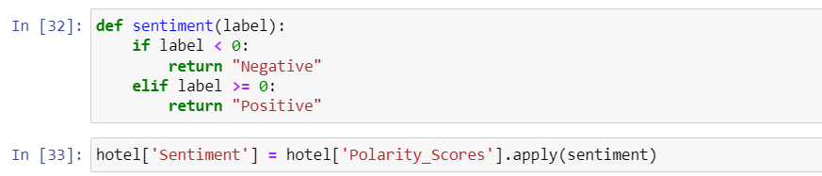
Feature Engineering
Here, we have applied sentiment analysis for the new cleaned review column and scores are calculated for each review
We have then labelled each score into 2 categories i.e. Positive and Negative which is our target variable

Slide 12
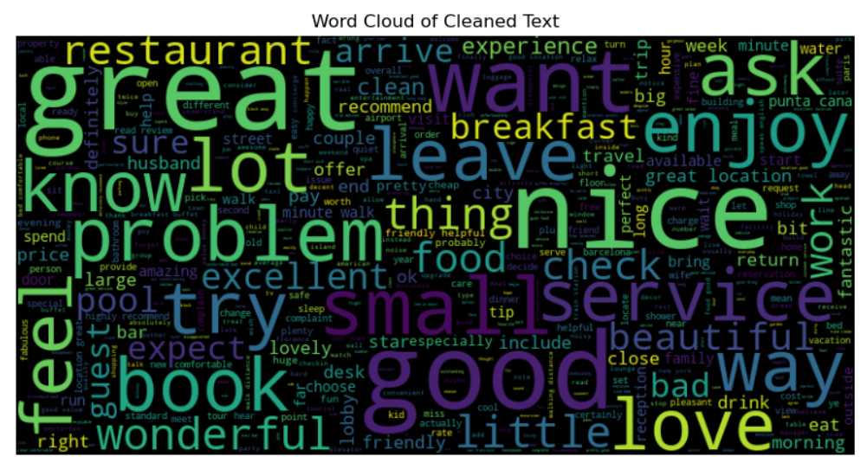
Feature Engineering
Here, we have a word cloud of the reviews after cleaning and lemmatizing the reviews

Slide 13
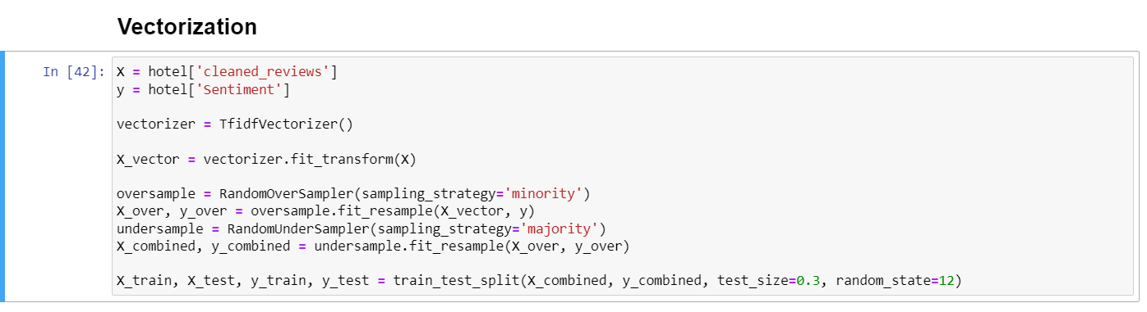
Vectorization
We have applied vectorization using Tfidf vectorizer to the review column and applied sampling to overcome class imbalance in the target variable.
We have then split the data to 70-30 split.

Slide 14
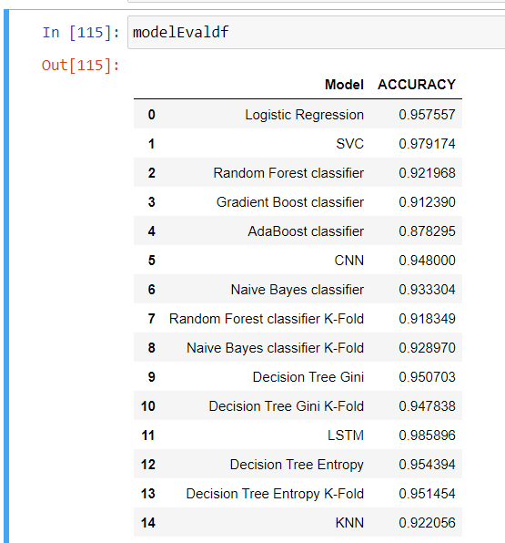
Model Building / Model Evaluation
After building model and training them we have evaluated the performance for all the models and updated them in the dataframe

Slide 15
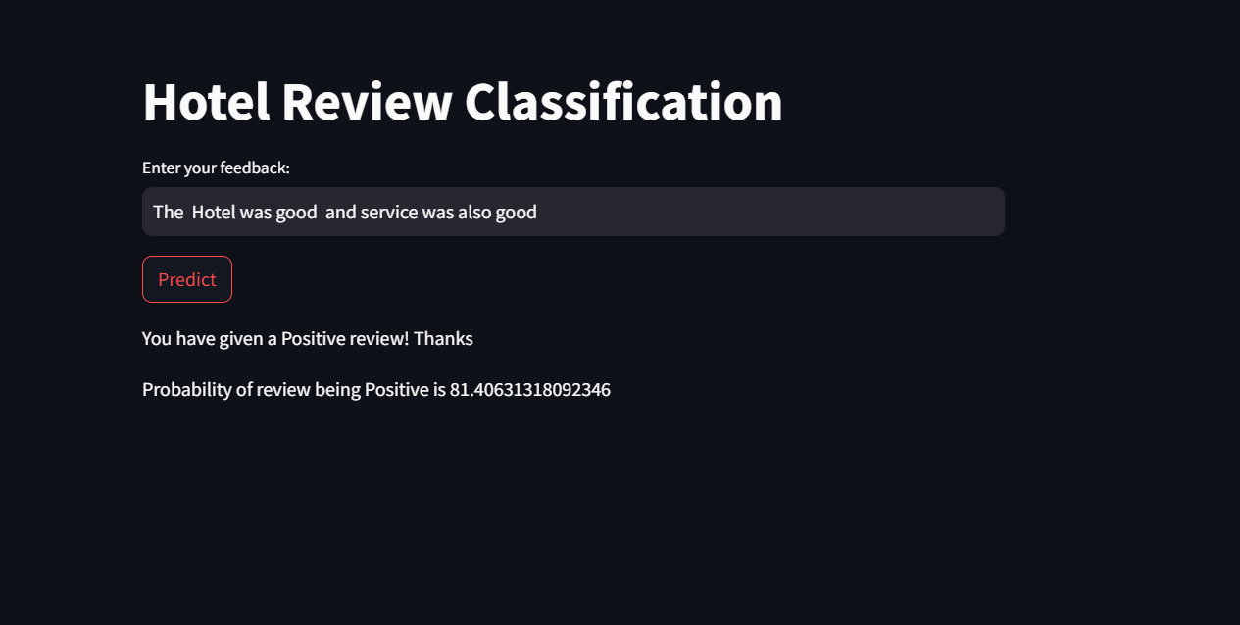
Deployment
By entering a review in the App, the relevant sentiment of the review will be predicted

Slide 16
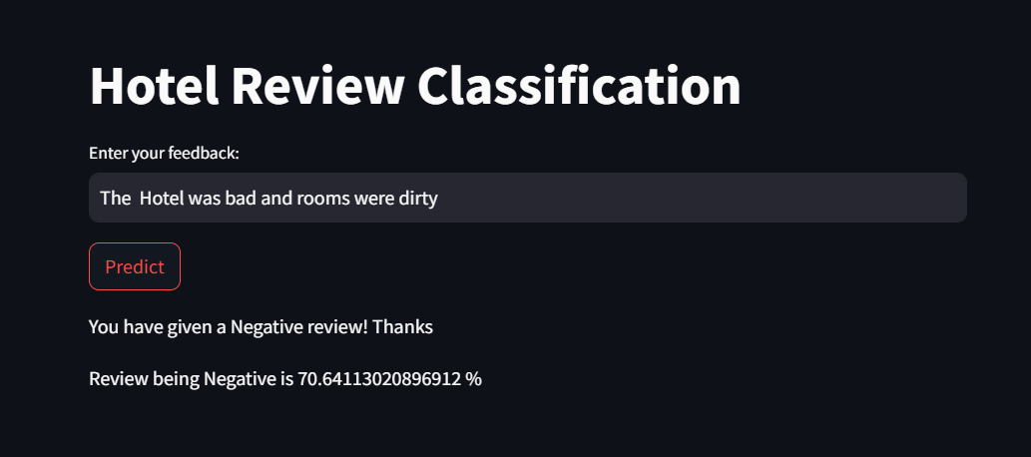
Deployment

Slide 17
Thank You

